Slide 1
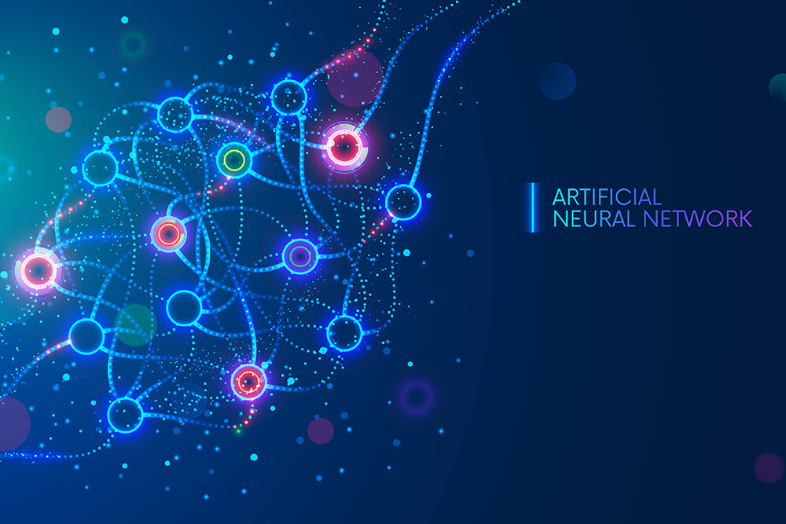

ANALISI DI MERCATO 2022-2023
SIAFA 28/04/2023
Serena Alderisi
M.Sc. Data Scientist

Slide 2



What about me?
Serena Alderisi (she/her)
Data Scientist and Machine Learning Expert at Siemens
Data Science Tutor and Equity Ambassador
Data Science Speaker
Born in Naples
Based in Madrid
Masters of Sciences in Data Science
Universidad Politécnica de Madrid
Bachelor Degree in “Statistica e Informatica per la
gestione delle imprese”
Universita degli studi di Napoli Parthenope
serena.alderisi@gmail.com
Serena Alderisi

Slide 3
What about you?

Slide 4
Table of Contents
Real World Applications
01
Intro
02
03
ANN definition
04
ANNs types
Course Introduction
Computer Vision, Healthcare, Covid-19 and other applications
Basic structure and General use case purpose
Different architectures and the most common ones

Slide 5
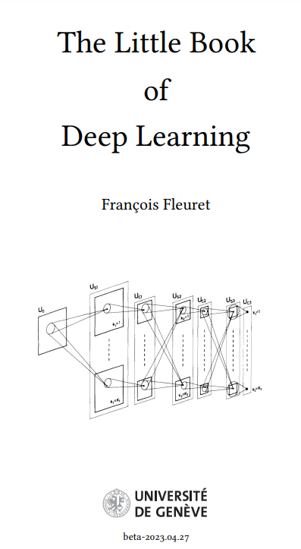
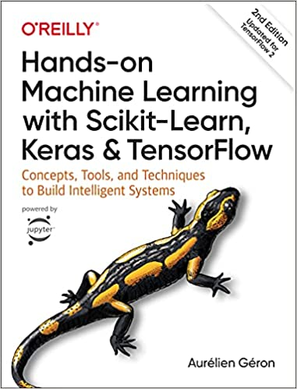


Reccomended Books

Slide 6


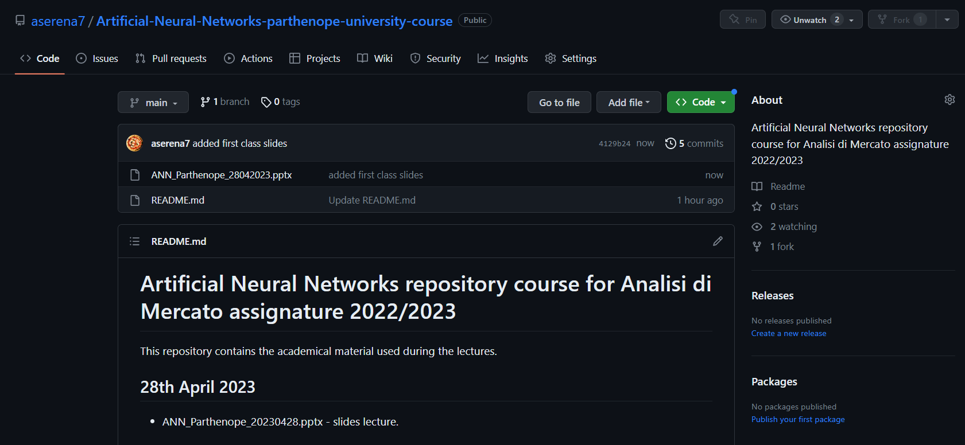

Course material

Slide 7


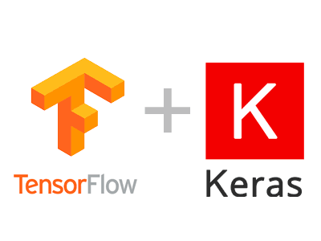
Course environment

Slide 8
AI, Machine Learning, ANN… What do you know about it?

Slide 9
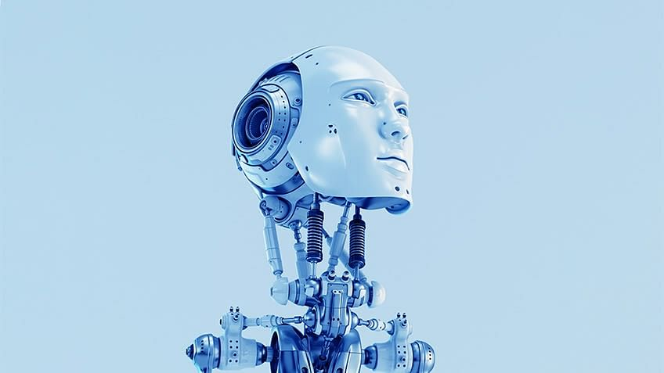
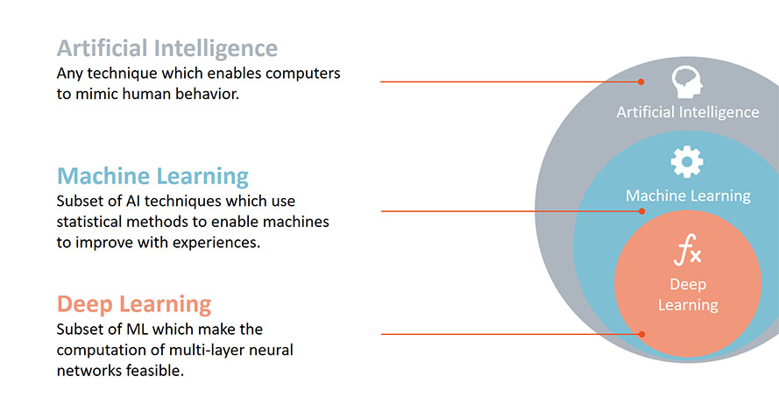
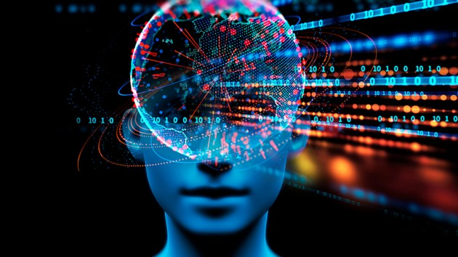
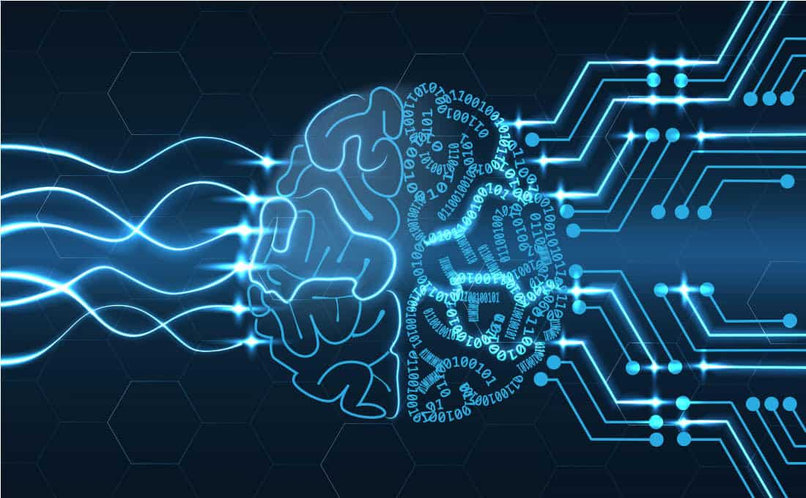
AI world contest

Slide 10
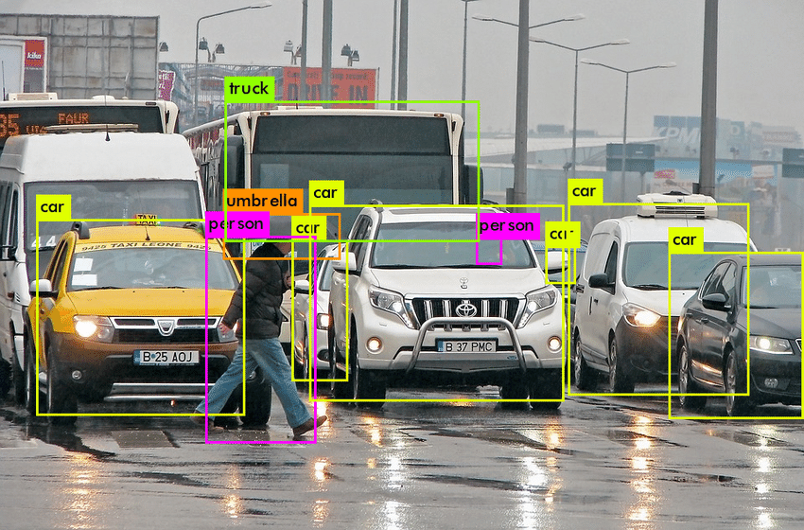

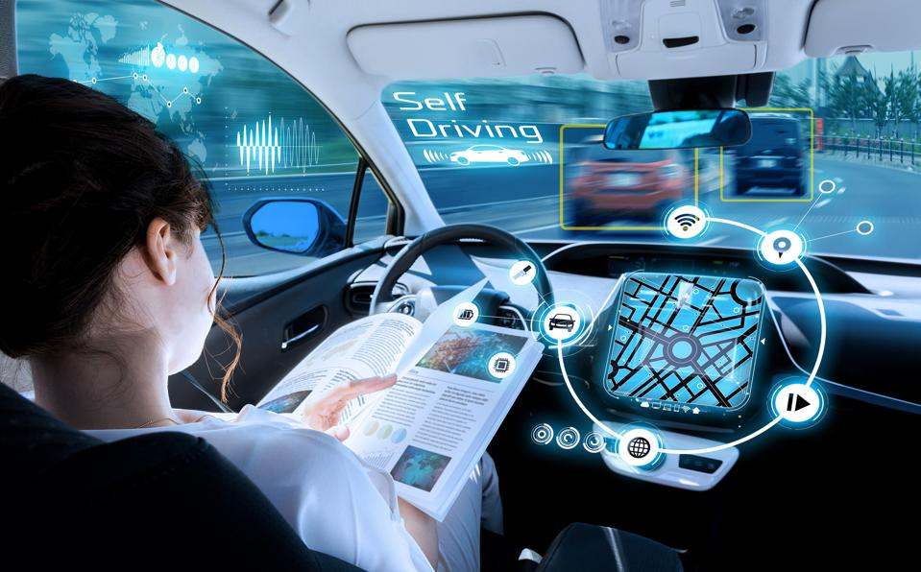
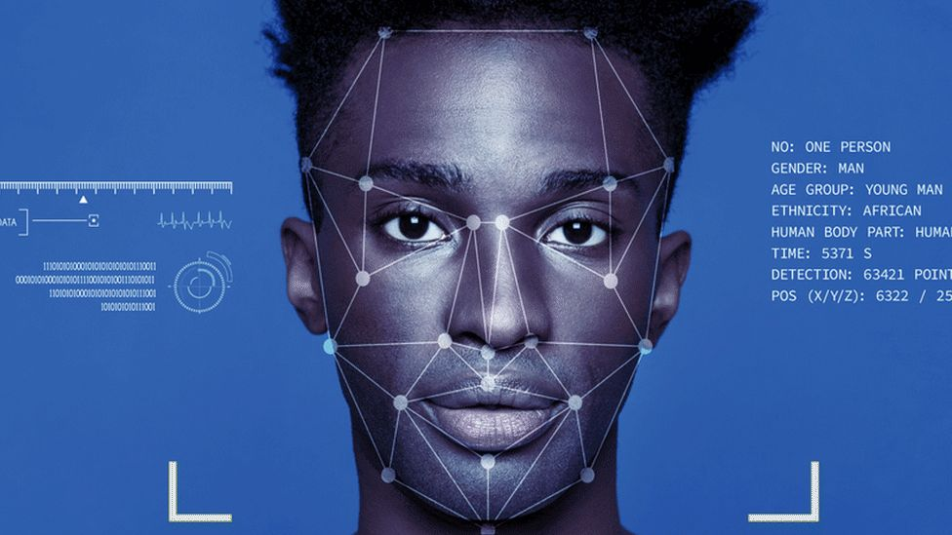
Computer Vision

Slide 11
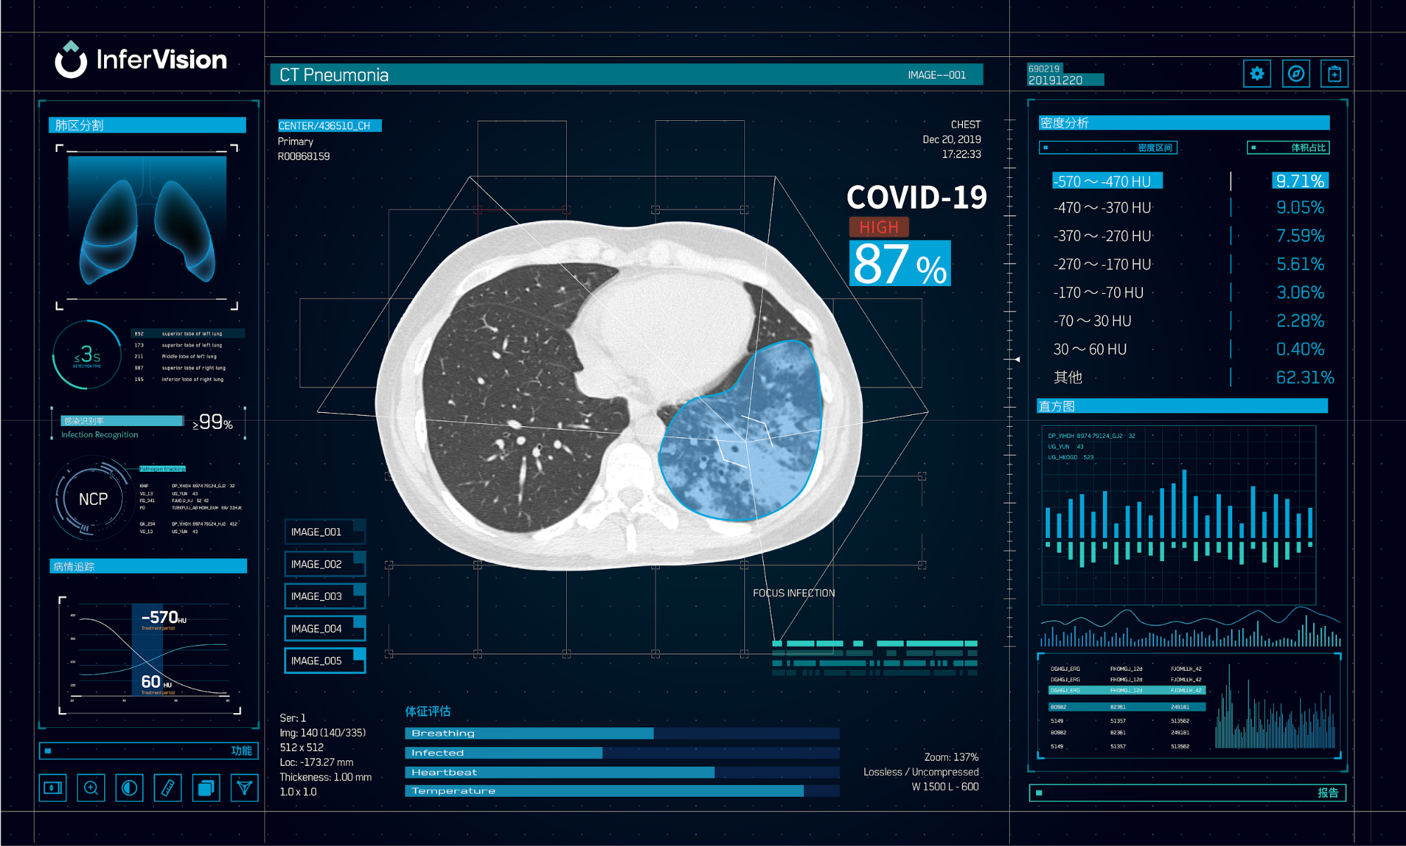
Healthcare

Slide 12
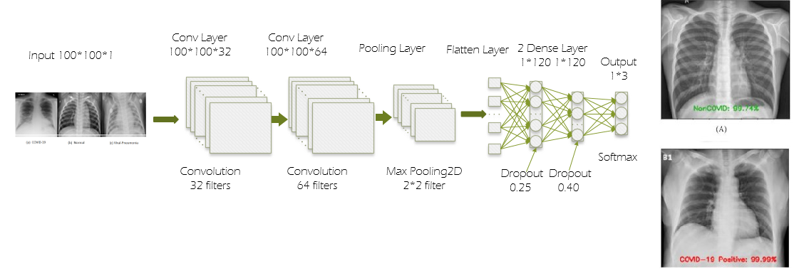
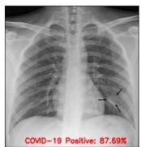
COVID-19
RESULTS
Earlier Diagnosis
More Accurate Diagnosis
Better ICU management
Resources Saving
Lifes Saving

Slide 13




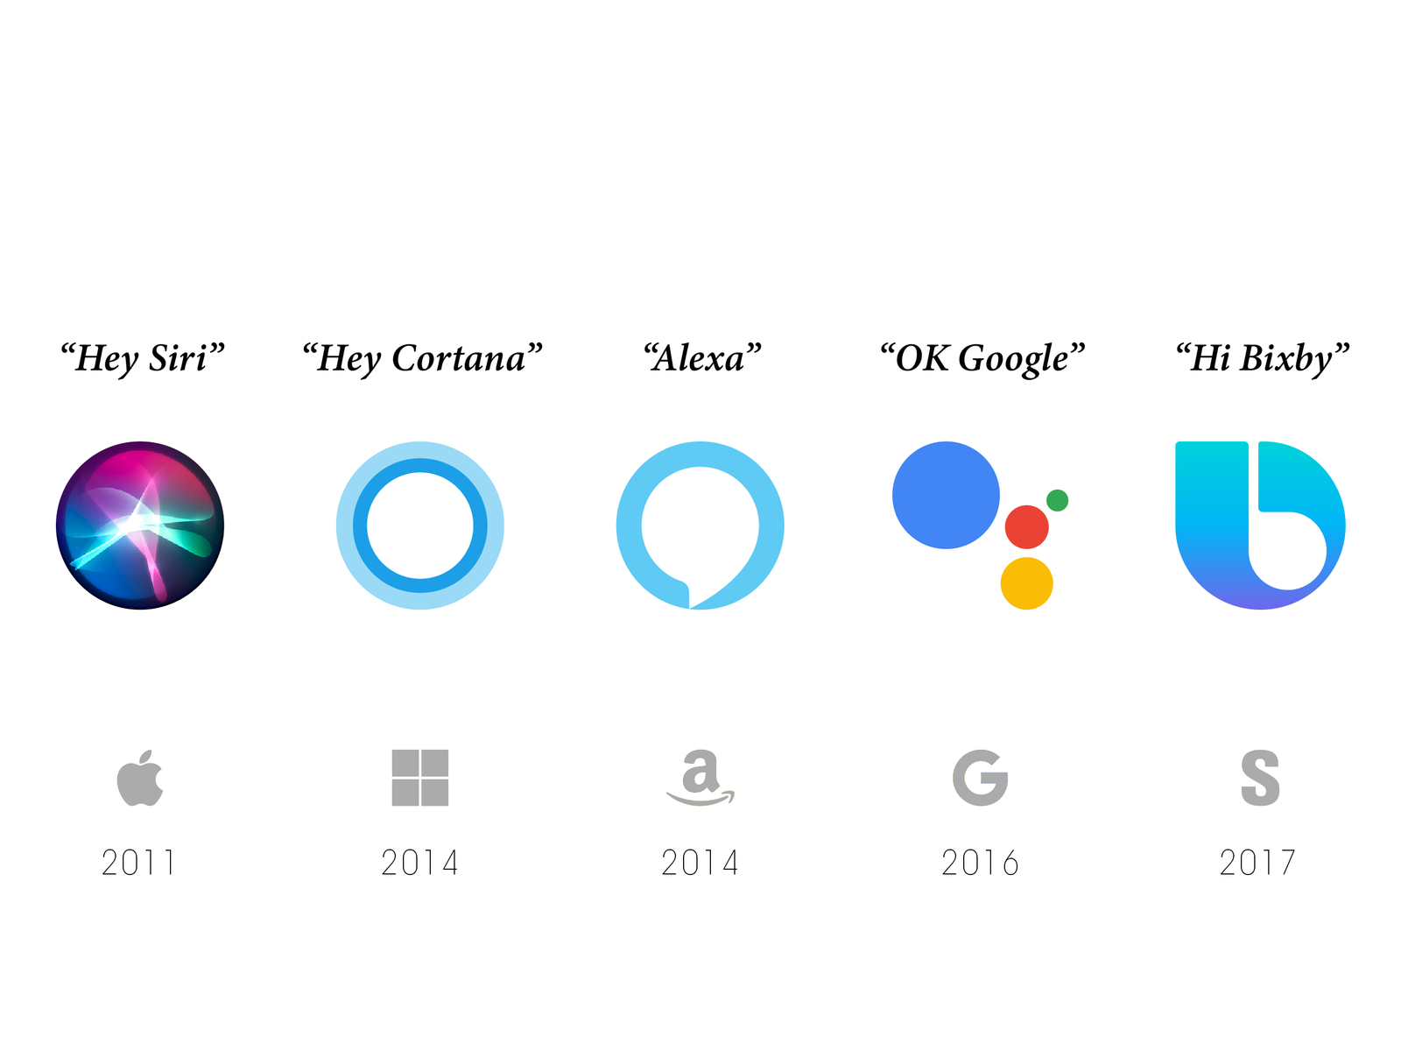

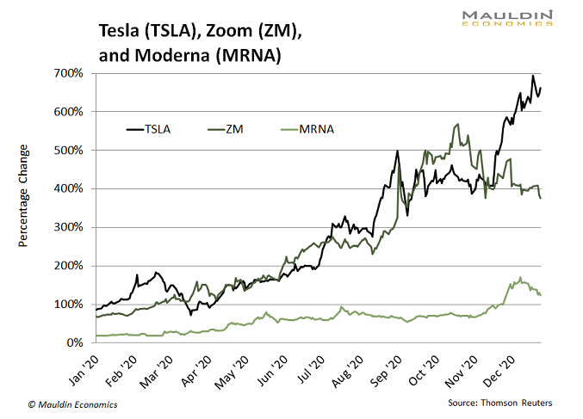


Other Applications

Slide 14
What do you know about Chat GPT?

Slide 15
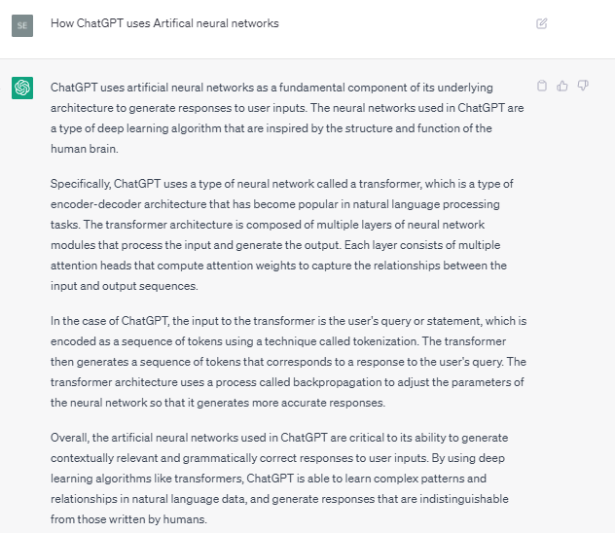
ChatGPT

Slide 16
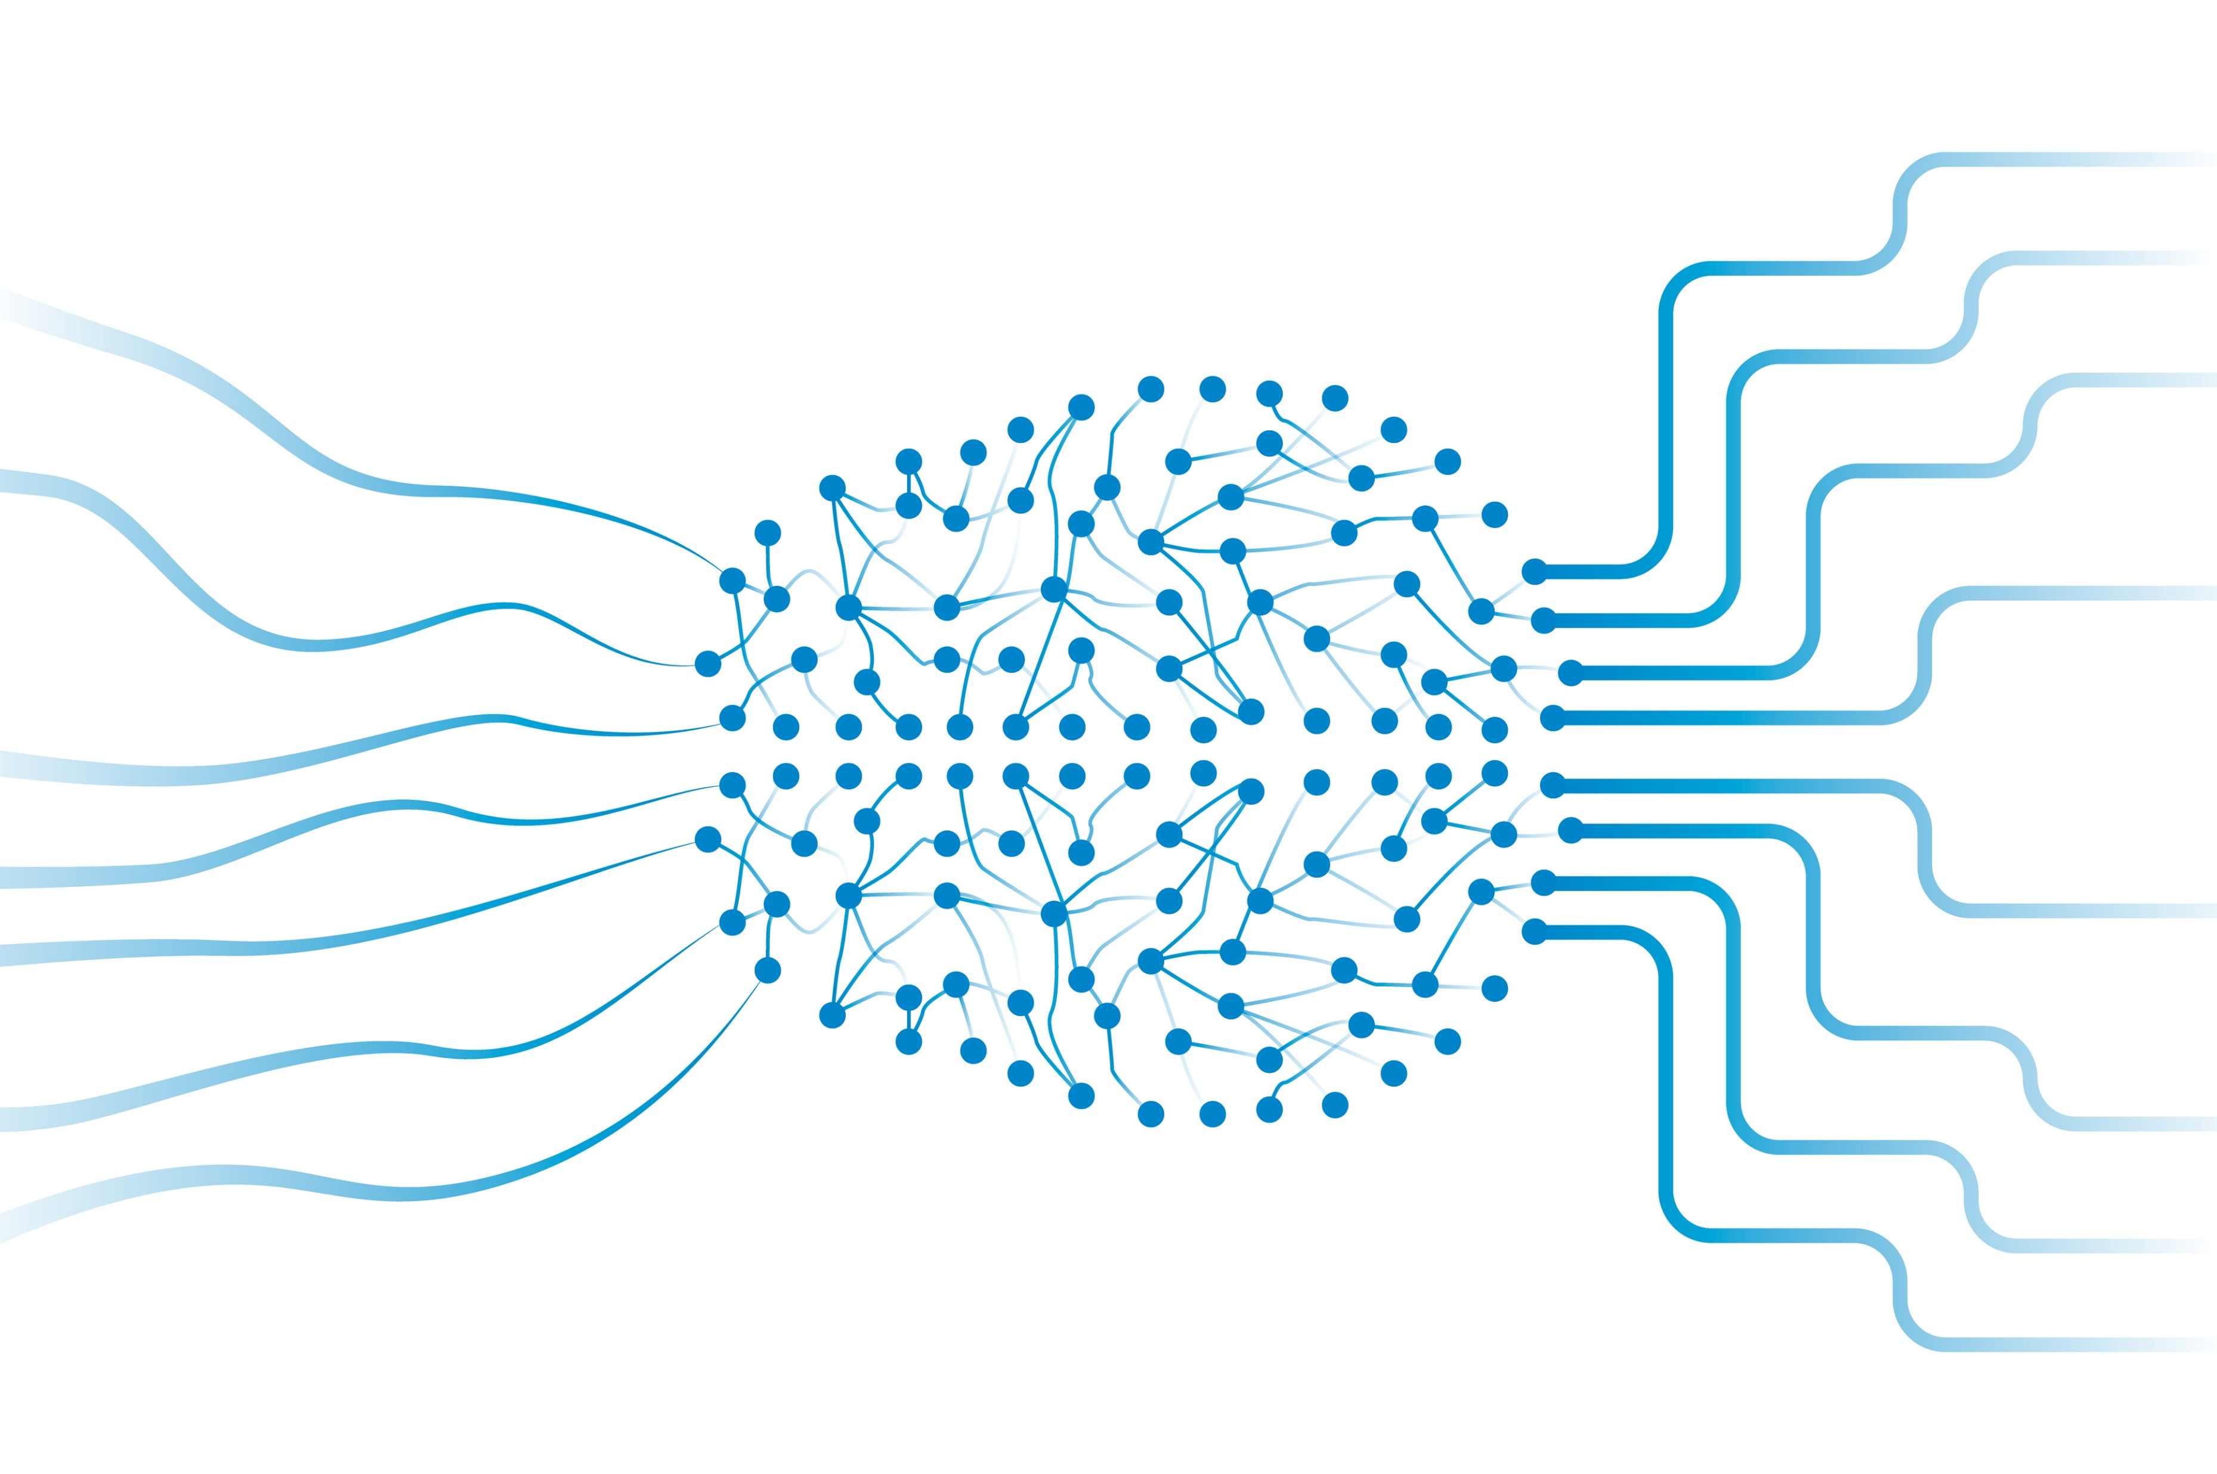
What is an ANN?
An artificial neural network (ANN) is a type of machine learning algorithm that is loosely based on the structure and function of the human brain.
ANNs consist of interconnected nodes, or "neurons", that are organized into layers. Exactly like the human brain, ANN work by processing data through a series of interconnected nodes, or "neurons".

Slide 17
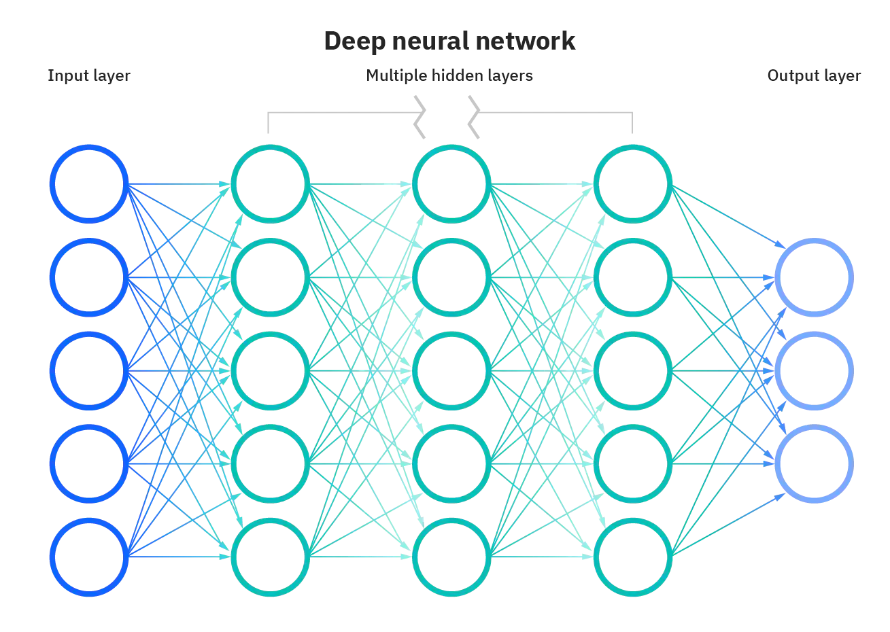
General ANN structure
Deep = More than 3 layers
The first layer is the input layer, where the information is known. The input layer receives data and passes it to one or more hidden layers, which process the data and pass it on to the output layer.
The last layer is the output layer, which directly links to the target value that the model attempts to predict.
The parameter of the ANN are adjusted during the training process in order to minimize a loss function, which measures how well the network is performing on a particular task.

Slide 18
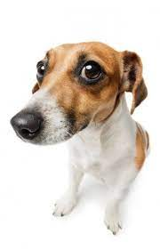
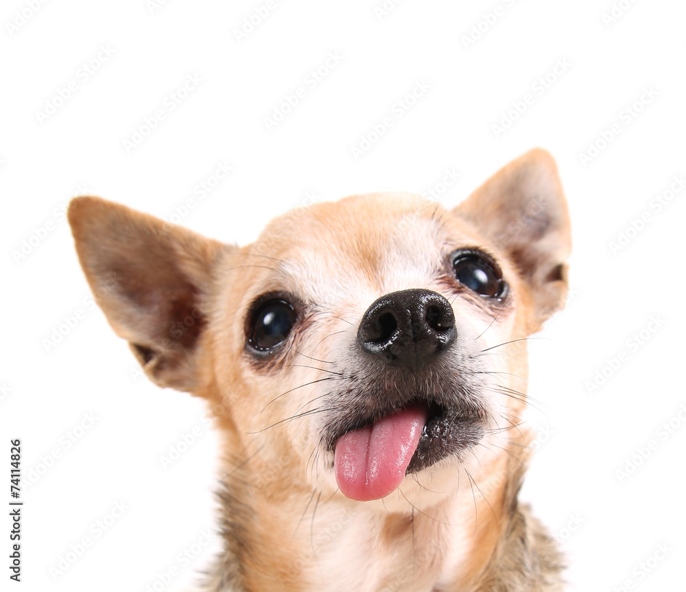
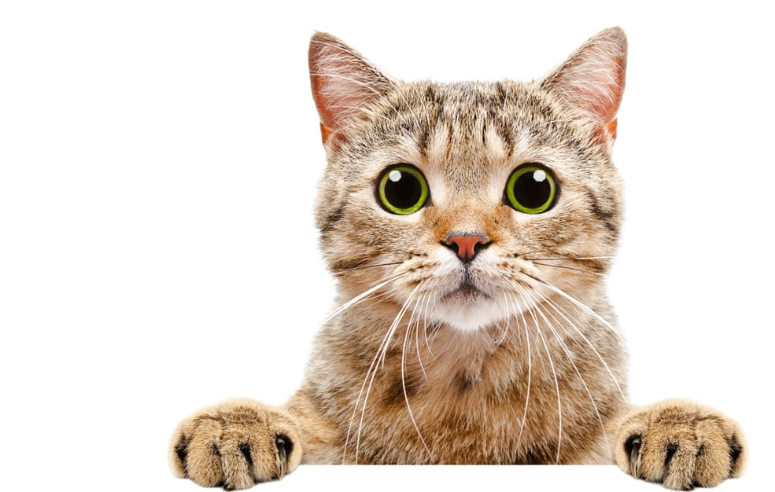
General ANN structure
The first layer is the input layer, where the information is known. The input layer receives data and passes it to one or more hidden layers, which process the data and pass it on to the output layer.
The last layer is the output layer, which directly links to the target value that the model attempts to predict.
The parameter of the ANN are adjusted during the training process in order to minimize a loss function, which measures how well the network is performing on a particular task.
Dog: 60%
Cat: 40%

Slide 19
General ANN structure
Feedforward neural networks (FFNNs)
Primarily used for tasks such as classification, regression, and prediction.
FFNNs consist of multiple layers of interconnected neurons, with each layer passing its output to the next layer without any feedback connections. The input data flows in one direction, from the input layer to the output layer. These networks are "feedforward" because the data only moves forward through the layers, without any feedback or loops.
Dog: 60%
Cat: 40%

Slide 20
Different types of ANN
Most commonly used types of ANNs:
Feedforward neural networks (FFNNs)
Convolutional neural networks (CNNs)
Recurrent neural networks (RNNs)
Long short-term memory (LSTM) networks
Autoencoder neural networks
Generative adversarial networks (GANs)
Hopfield networks
Boltzmann machines
Self-organizing maps (SOMs)
Adaptive resonance theory (ART) networks
Each type of ANN has its own unique architecture and purpose, strengths and weaknesses and is best suited to different types of problems.

Slide 21

Different types of ANN

Slide 22
Different types of ANN
Feedforward neural networks (FFNNs) | Can be used for a wide variety of tasks, including image classification, speech recognition, and language translation. They are particularly well-suited for problems where the input data is high-dimensional and complex, and where there is a large amount of training data available.
Convolutional neural networks (CNNs) | Great ability to extract features from the input data. This allows the network to identify patterns and features at different scales. CNNs are commonly used for image and video recognition tasks, such as object detection, facial recognition, image classification, natural language processing and speech recognition.
Recurrent neural networks (RNNs) | Designed to process sequential data, such as time-series data or natural language text. Unlike feedforward neural networks, which process all of the input data in one go and produce a fixed-size output, RNNs operate on a sequence of inputs, producing a sequence of outputs.
Long short-term memory (LSTM) networks | commonly used for tasks such as speech recognition, natural language processing, and time-series prediction. They are particularly well-suited for problems where the input data is sequential and has long-term dependencies by incorporating a memory cell.

Slide 23
Reccomended Readings
Machine Learning vs Deep Learning
Make your own instagram fiter with-facial recognition
Machine Learning applied to Covid 19 research paper
Infervision AI tool by Alibaba
Deep Learning applications
Neural Networks Applications
Fraud detection with machine learning 5 uses cases

Slide 24
What’s next?
Choose your buddy!

Slide 25
THANK YOU! Any Questions?

